Slide 1

Project Title: Electric Motor Temperature
Name of the team | P_258 Group_5
Date of formed | 27/06/2023
Mentor | K S Siri
Team Members | Mr. Tirumala Srikanth Mr. Shashikant Shivaji Chikhale Mr. Chinna Narasimhulu Mr. Gautham B Raj Miss. Vaka Durga Rushipriya
Meeting time | Every Week Tuesday
Meeting Duration | 1 Hour

Slide 2
Problem statement:
Predict Motor Speed based on other attributes available
Data Collection:
The Dataset is collected from a permanent magnet synchronous motor (PMSM) deployed on a test bench. The PMSM represents a ccTest bench measurements were collected by the LEA department at Paderborn University. This dataset is mildly anonymized

Slide 3
Feature Information:
ambient: Ambient temperature as measured by a thermal sensor located closely to the stator.
coolant: Coolant temperature. The motor is water cooled. Measurement is taken at the outflow.
u_d: Voltage d-component
u_q: Voltage q-component
motor_speed: Motor speed
torque: Torque induced by current.
i_d: Current d-component
i_q: Current q-component
pm: Permanent Magnet surface temperature representing the rotor temperature. This was measured with an infrared thermography unit.
stator_yoke: Stator yoke temperature is measured with a thermal sensor.
stator_tooth: Stator tooth temperature is measured with a thermal sensor.
stator_winding: Stator winding temperature measured with a thermal sensor.
profile_id: Each measurement session has a unique ID. Make sure not to try to estimate from one session onto the other as they are strongly independent.

Slide 4
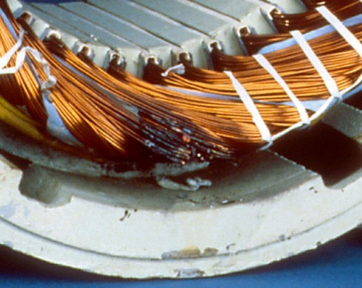
This is a typical stator winding damage:
On the rotor part, irreversible demagnetization of the permanent magnets can be caused by overheating, which represents an even more severe instance of motor damage.

Slide 5
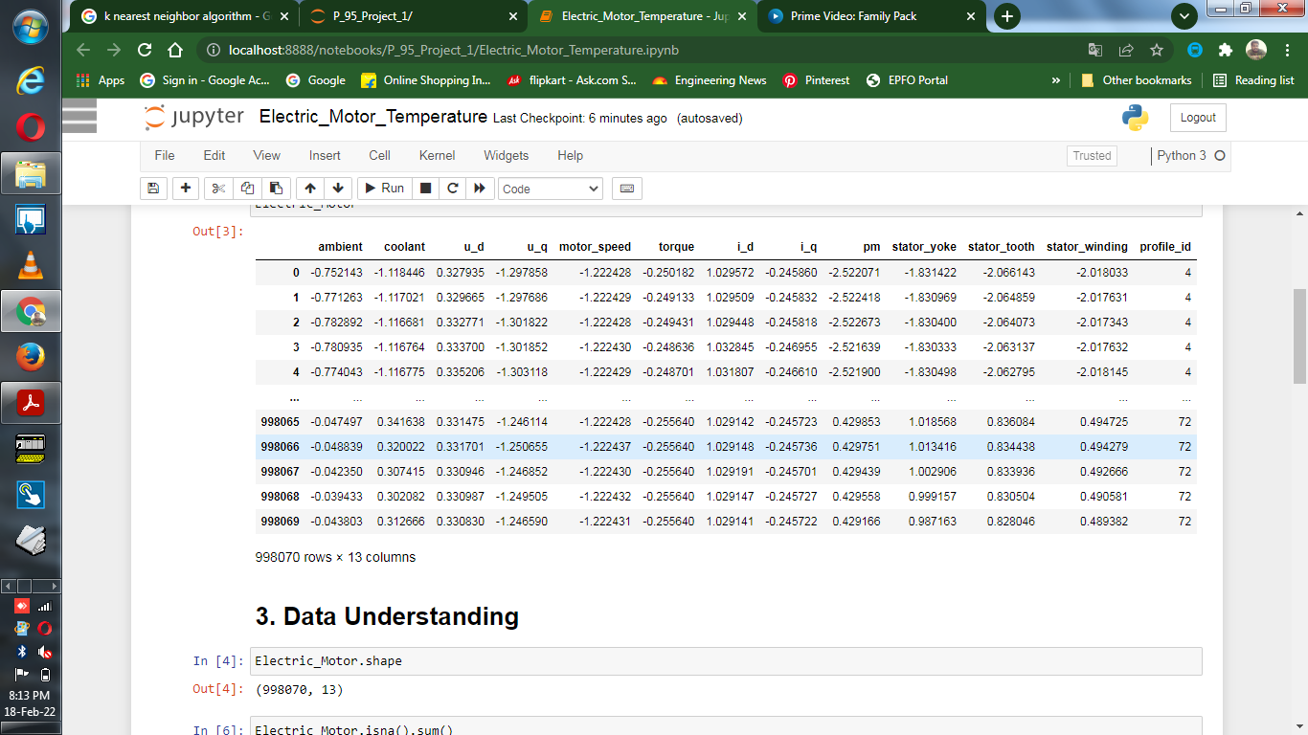
Data set details
Data set: Temperature data of electric motor
998070 Observations & 13 features
There is no null values in the entire data sets
Profile_Id has 52 unique values

Slide 6
Project Architecture / Project Flow
Data cleansing
Duplicate values removal
Missing values treatment
EDA
Outlier treatment
Feature Engineering
Data pre processing
Data type conversion
Normalization/ Standardization
Data visualisation
Model building
Regression model
Tree model
Model deployment

Slide 7
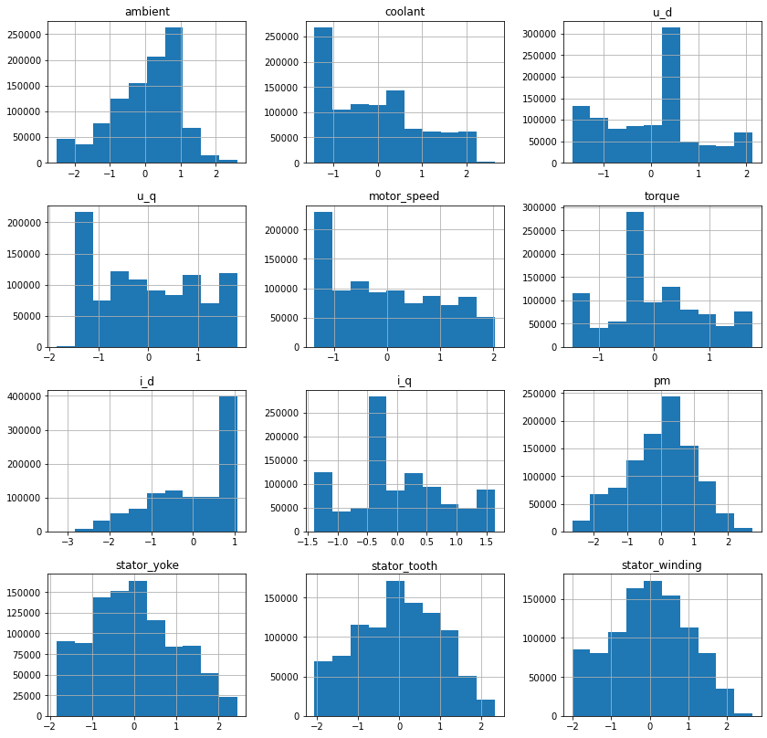
Exploratory Data Analysis (EDA)
Histogram for checking whether my data is normally distributed or not

Slide 8
Exploratory Data Analysis (EDA)
There are no Null values in the dataset
There are no categorical values in the dataset
Now find the correlation ship between the variables. There is a collinearity also.
Now we have to make the profile_id into unique, by doing this we will come to know how many levels are there.
The data set will follow normality.
When we used scatterplot we came to know about linearity. Data set follows positive linearity.
Histogram and bar plot will help us to find the variation in the data set.
Heat plot will tell us whether there are any NA values and correlation of the variables.
There are outliers in the data set. Before performing model building we have to treat the outliers..

Slide 9
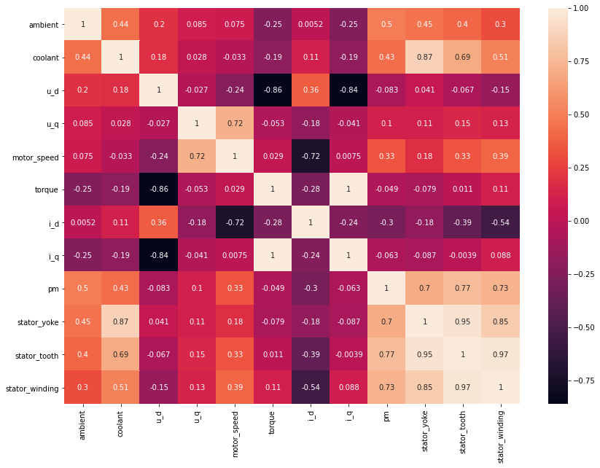
Exploratory Data Analysis (EDA)
Highly Correlated Features:
Coolant & Stator_yoke
Torque & i_q
i_q & Torque
pm & Stator_winding
Staor_yoke & Stator_tooth
Stator_tooth & Stator_winding
Stator_winding & Stator_tooth

Slide 10
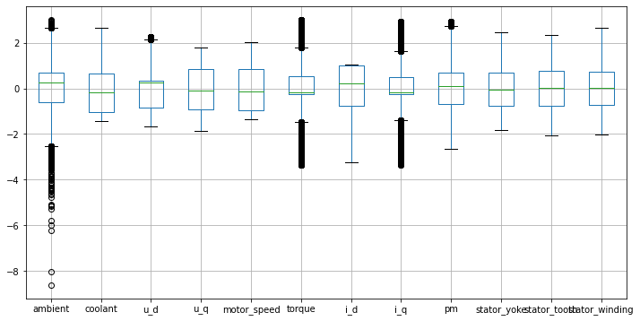
Exploratory Data Analysis (EDA)
Outliers:
Ambient
u_d
Torque
i_q
pm
Outliers are removed Using IQR Technique

Slide 11
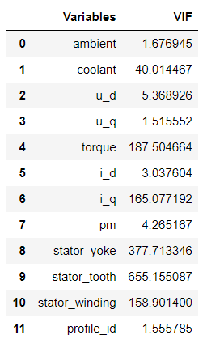
VIF Between the Independent variable:

Slide 12
Model Building
In this project, We investigate the usage of different models to predict the output
Motor_speed
Regressor Models
1) "LinearRegression"
2) "Lasso Regression"
3) "Ridge Regressor"
4) "Elasticnet"
5) "K-Neighbors Regressor"
6) "Decision Tree"
7) "LinearSVR"
8) "Random Forest Regressor”
9) "XGBRegressor”
10) "AdaBoost Regressor”

Slide 13

1. Linear Regressor Model
Linear Regression is a supervised machine learning algorithm where the predicted output is continuous and has a constant slope. It's used to predict values within a continuous range.
LinearRegression Model Training Performance
RMSE: 0.2717304643557357
MAE: 0.20194591174710375
R2score 92.64719607467624

Slide 14
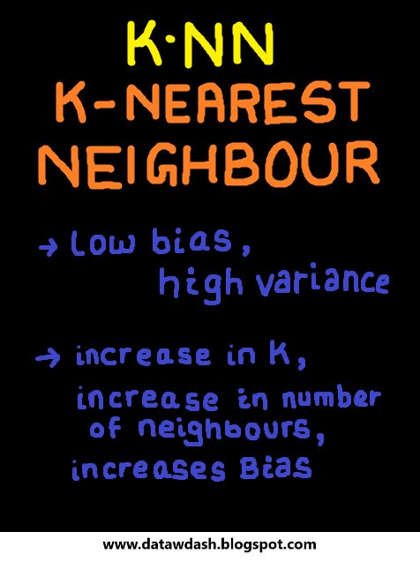
2. KNN Regressor Model
Implementation of KNN regression is to calculate the average of the numerical target of the K nearest neighbors. Another approach uses an inverse distance weighted average of the K nearest neighbors. KNN regression uses the same distance functions as KNN classification
K-Neighbors Regressor
Model Training Performance
RMSE: 0.028846766048126277
MAE: 0.011484620495863004
R2 score 99.91713510435602

Slide 15

3. XG_Boosting Regressor Model
XGBoost is an efficient implementation of gradient boosting that can be used for regression predictive modeling.
XGBRegressor
Model Training Performance
RMSE: 0.031550939972017356
MAE: 0.017330661097826133
R2 score 99.90087095373723

Slide 16

4. Ada_Boosting Regressor Model
An AdaBoost regressor. An AdaBoost regressor is a meta-estimator that begins by fitting a regressor on the original dataset and then fits additional copies of the regressor on the same dataset but where the weights of instances are adjusted according to the error of the current prediction.
AdaBoost Regressor
Model Training Performance
RMSE: 0.2623805975622531
MAE: 0.22361844809751336
R2 score 93.1444901891165

Slide 17

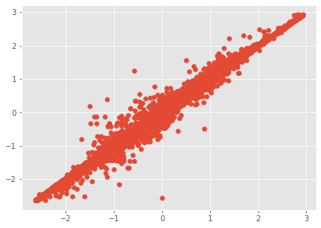
5. Random Forest Regressor Model
Random Forest Regression is a supervised learning algorithm that uses ensemble learning method for regression. Ensemble learning method is a technique that combines predictions from multiple machine learning algorithms to make a more accurate prediction than a single model.
Random Forest Regressor
Model Training Performance
RMSE: 0.021827459584282
MAE: 0.00820080105899216
R2 score 99.95255584582114

Slide 18

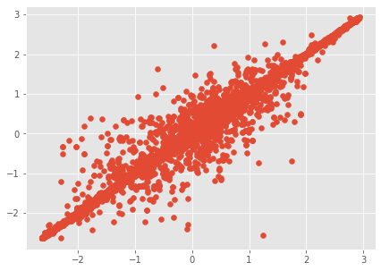
6. Dicision Tree Model
Decision tree builds regression or classification models in the form of a tree structure. It breaks down a dataset into smaller and smaller subsets while at the same time an associated decision tree is incrementally developed. Decision trees can handle both categorical and numerical data
Decision Tree Model
Training Performance
RMSE: 0.027515066162255884
MAE: 0.010521760492002426
R2 score 99.92460935725035

Slide 19
7. Linear SVR
Based on support vector machines method, the Linear SVR is an algorithm to solve the regression problems. The Linear SVR algorithm applies linear kernel method and it works well with large datasets. L1 or L2 method can be specified as a loss function in this model.
LinearSVR
Model Training Performance
RMSE: 0.2887079968139182
MAE: 0.1816472273115665
R2 score 91.69969693473844

Slide 20
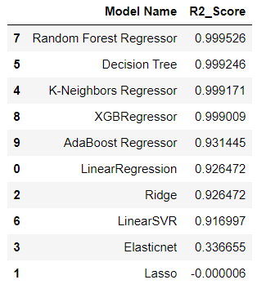
Models with best R2 values

Slide 21
Conclusion:
Therefore we got best model with Random Forest Regressor with 99.95% accuracy
Now next step is to create the main.py file for the deployment to predict the motor speed
Here, we are using Streamlit for the deployment

Slide 22


